Slide 1

Data landscaping and Feasibility
using the EHDEN Portal and OMOPsketch
Epidemiology Track Day 1
Monday, 17th June 13.30-16.30h

Slide 2
Schedule
13.30 – 13.45 Introductions
13.45 – 14.00 EHDEN Portal Demo: Data Landscaping
14.00 – 14.20 Breakout session: Exploring the EHDEN Portal
14.20 – 14.30 Research questions
14.30 – 15.00 Breakout session: Data requirements
15.00 – 15.15 Coffee Break
15.15 – 15.30 Discussion of Data requirements
15.30 – 16.00 Breakout session: Using the portal to get feasibility counts
16.00 – 16.15 Discussion of feasibility counts
16.15 – 16.30 OMOP sketch

Slide 3

Introductions

Slide 4
Real World Databases

Slide 5
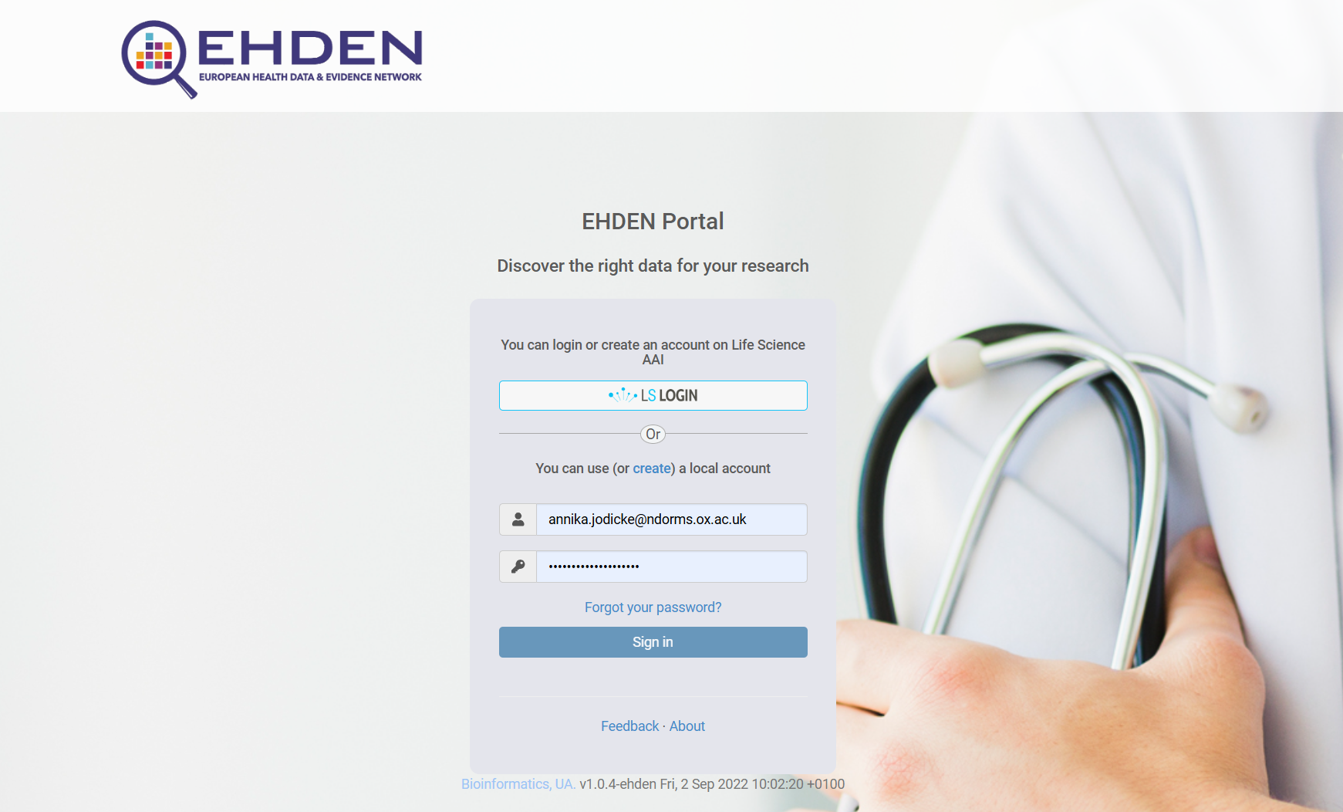
EHDEN Portal Database
https://portal.ehden.eu/login?ref=community/join/EHDEN

Slide 6
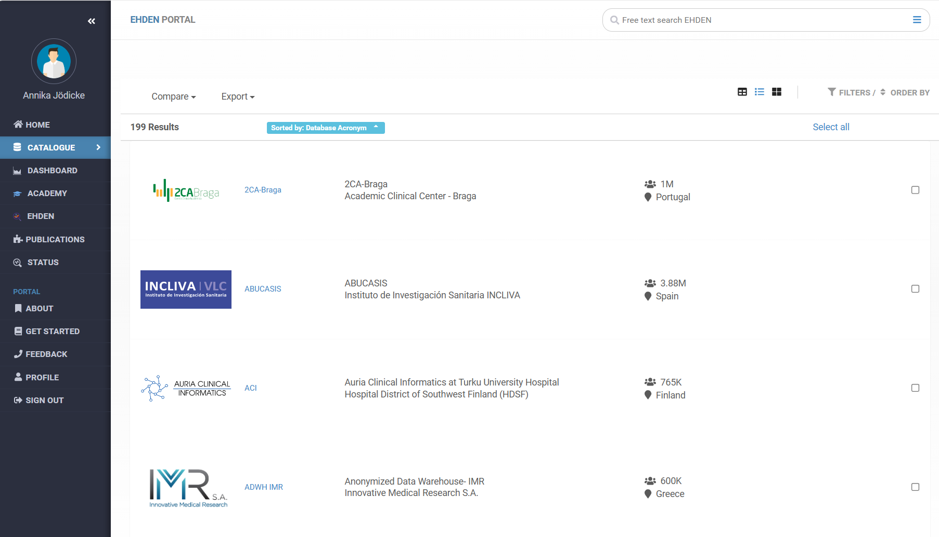
EHDEN Portal Dashboard

Slide 7
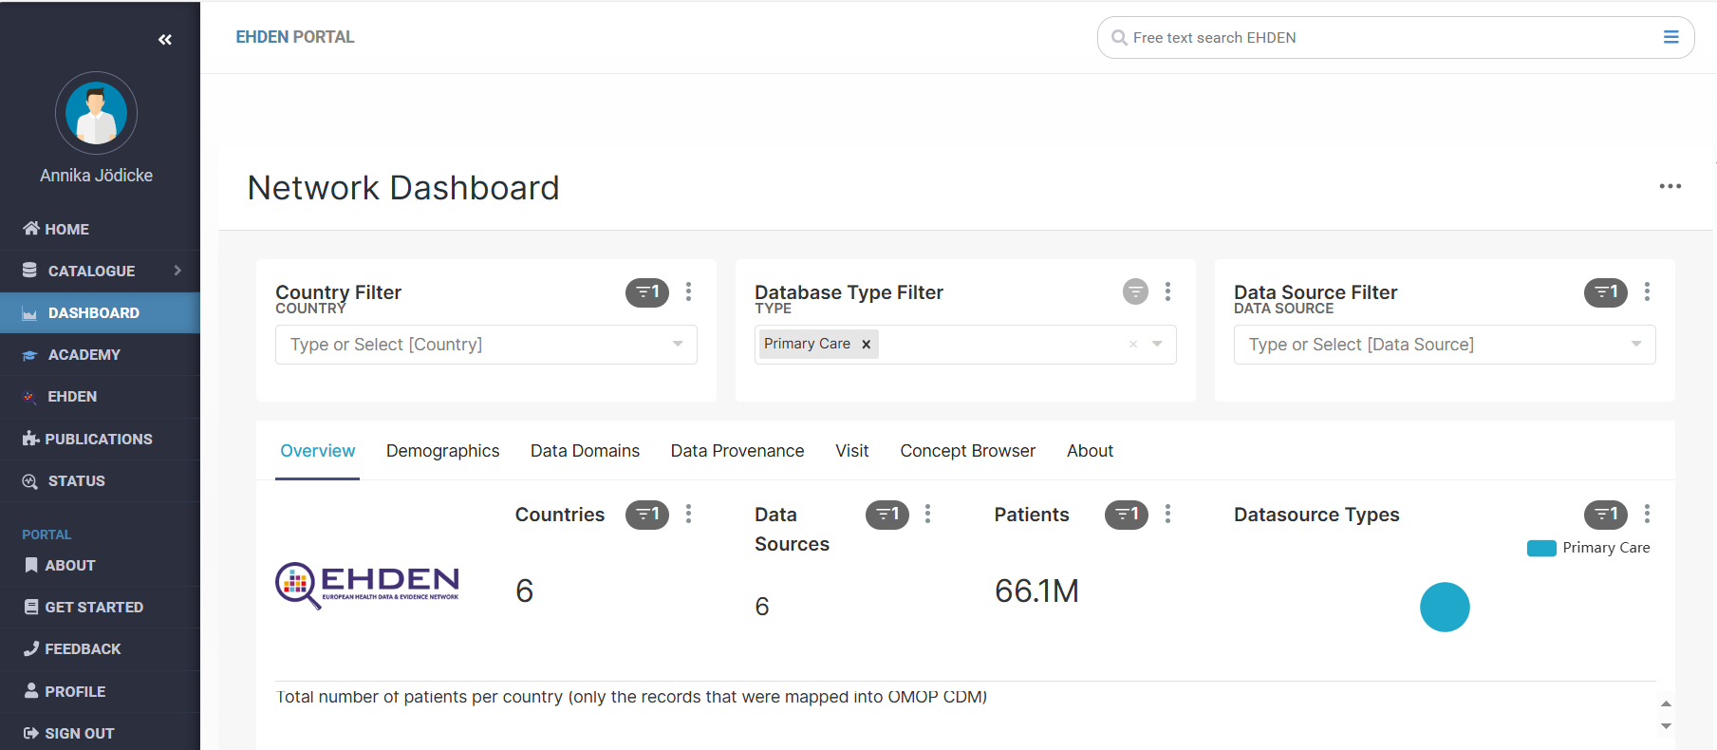
EHDEN Portal Catalogue

Slide 8
Your turn 15mins
Group practical: Exploring the EHDEN Portal
Meet in groups of 3 people from different organisations
Explore the EHDEN catalogue
Choose
One database type, e.g. primary care, hospital, registry
Compare database size, distribution of demographics, start of data collection

Slide 9
Research question
What makes a great research question?
Feasible (n, technical, time, £, scope)
Interesting (intriguing answer)
Novel (confirm, refute, extends, new)
Ethical (IRB approval)
Relevant (science, clinical, future research)
Does it answer the question …so what?
Notes:
Feasible – It is best to know the practical limits and problems of studying a question early on, before wasting much time and effort.
Number of subjects: Can you enrol enough subjects (sample size, number consent to take part, refuse to participate, loss to follow up, enough patients seen in clinical setting want to recruit from)
Technical expertise: Does the team have the skills and experience to design study, recruit patients, manage data. Do you have the technology to do it within your institution e.g. analyzing samples in lab and cost of this.
Cost in time and money: How long do you have to complete the study? How much it will cost? Do you have enough money?
Scope: Scope of the study may be too big – too many secondary outcomes, collecting too much data – focus on important questions
Interesting – must be something that interests you. Must interest funding bodies. To know if your research question is interesting, you should talk about it with mentors, outside experts, and representatives of potential funders such as NIH project officers before developing the analysis plan.
Novel – you have to become masters of the literature. Chances are someone has already answered your question. Even so, could it be done better.
Ethics – need to obtain ethical approval. Is it too risky for patients?
Relevant – this is the so what bit? How does this change clinical practice or influences health policy? How does it advance the scientific knowledge?

Slide 10
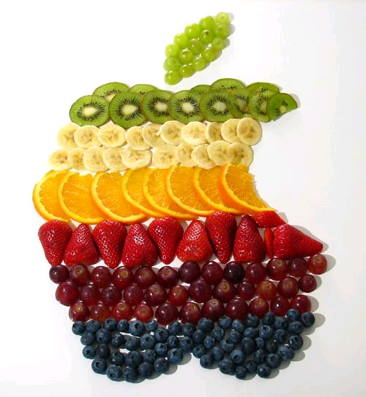
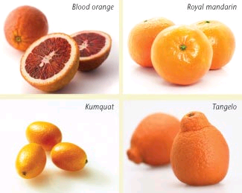
Research question
Picking the best Research question
The research question should clearly describe the key attributes of the study…

Slide 11
Research question: PICO
Patient or population of interest
Intervention or exposure
Comparison group
Outcome
Notes:
A good PICO research question should clearly define how you will study the association between predictors (intervention vs comparator) & outcome in a prespecified study population
To identify the components of a clinical research question, using the PICO framework. The PICO stands for…
P is for …
Patient or Population: who is receiving the treatment and what are their characteristics?
How are you going to describe your population?
What are the most important characteristics of the people you are studying
I is for..
Intervention or interest: what are you plan to do?
C is for..
Comparator: what are the alternative method/treatment you are going to use?
O is for..
Outcome: what do you expect to see or what do you expect to happen?

Slide 12


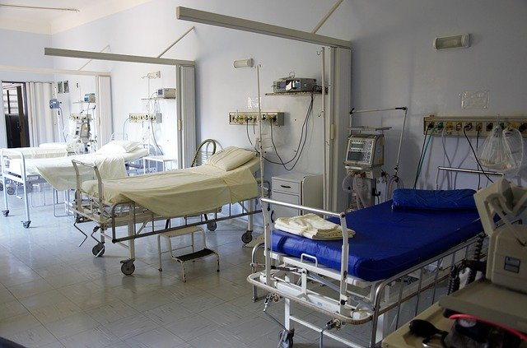

Which Population?
Notes:
Now, I am going to go in more details in what each letter means
Patient
How are you going to describe your population?
What are the most important characteristics of the people you are studying
This will include the primary problem disease or co-existing conditions.
You should think about some of the main characteristics of your target population, such as age, sex/gender, ethnicity and location are additional descriptors that may be relevant to your research question

Slide 13




Which Exposure? Which Comparator?
Notes:
What may intervention, prognostic factor, diagnostic test or exposure are you considering? What do you want for the patient/individual: prescribe drugs, performance tests, ordered surgery
The comparison and PICO can be thought of as the group you are comparing your intervention/exposure/test. Alternatively you are trying to decide between two drugs, or a drug and no medication or placebo or two diagnostic test

Slide 14



Which Outcome?

Slide 15
Your turn 30mins
Group practical: Data requirements
Meet in your groups
Take a research question
Define the PICO
Define “requirements” of the data you’d need to answer your research question e.g. setting, covariates, level of detail

Slide 16

Coffee break 15mins

Slide 17
Discussion 15mins
Each group:
1) What is your PICO research question
2) What real-world data would you need to answer your research question?

Slide 18
Your turn again 30mins
Group practical: Data selection and feasibility counts
Meet in your groups
Select databases covering the right “setting” from the Catalogue
Check concept counts for the databases for your exposure and outcome
Which would be the final databases for your study?

Slide 19
Discussion 15mins
Each group:
Which databases would you select?
Did feasibility counts help to shortlist databases from your initial list?

Slide 20
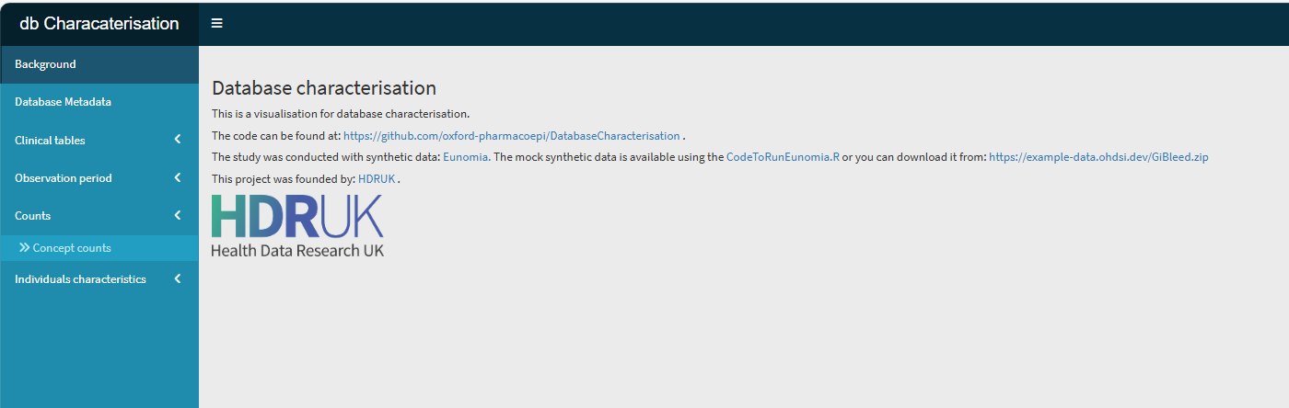
OMOPsketch 15mins
dpa-pde-oxford.shinyapps.io/databaseCharacterisation/

